Slide 1
MONEYBALL
An Intelligent Soccer Player Valuation & Transfer Marke System
Liujun Xue 001222405
Wenhe Ma 001237805

Slide 2
Problem Statement
Huge market
During the 2016 summer transfer window, clubs from England, France, Germany, Italy, and Spain completed 1,504 incoming transfers and spent USD 2.75 billion in transfer fees.
Asymmetirc Information
Mulityple Factor and High Uncertainty

Slide 3
Solution
For buying club:
Value added = Increased revenue – player salary in buying club
For selling club:
Value lost = Decreased revenue – player salary in selling club

Slide 4
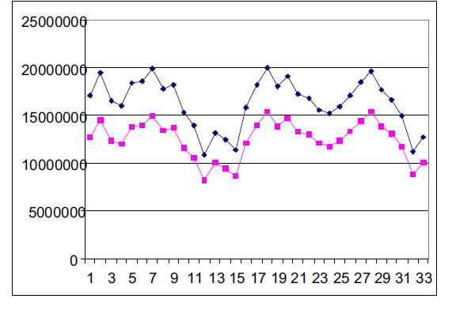
Research
The Value of Thierry Henry for Arsenal and for ManU with the value of one point equal to ￡500)

Slide 5
Research
Factors On Index
Healthiness
Skills
Fame/Popularity

Slide 6
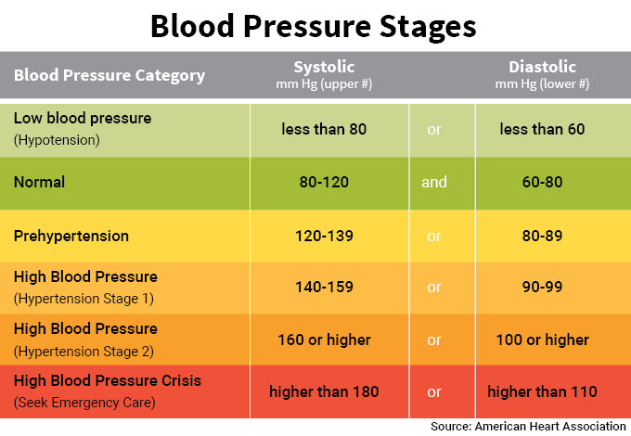
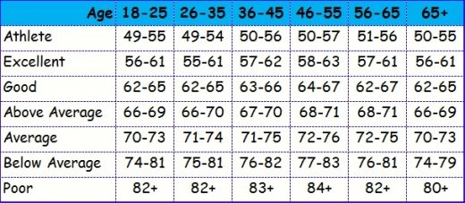
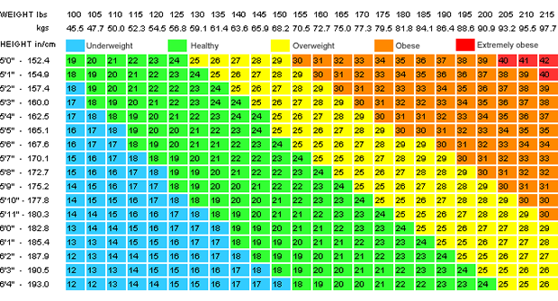
Research
Research

Slide 7
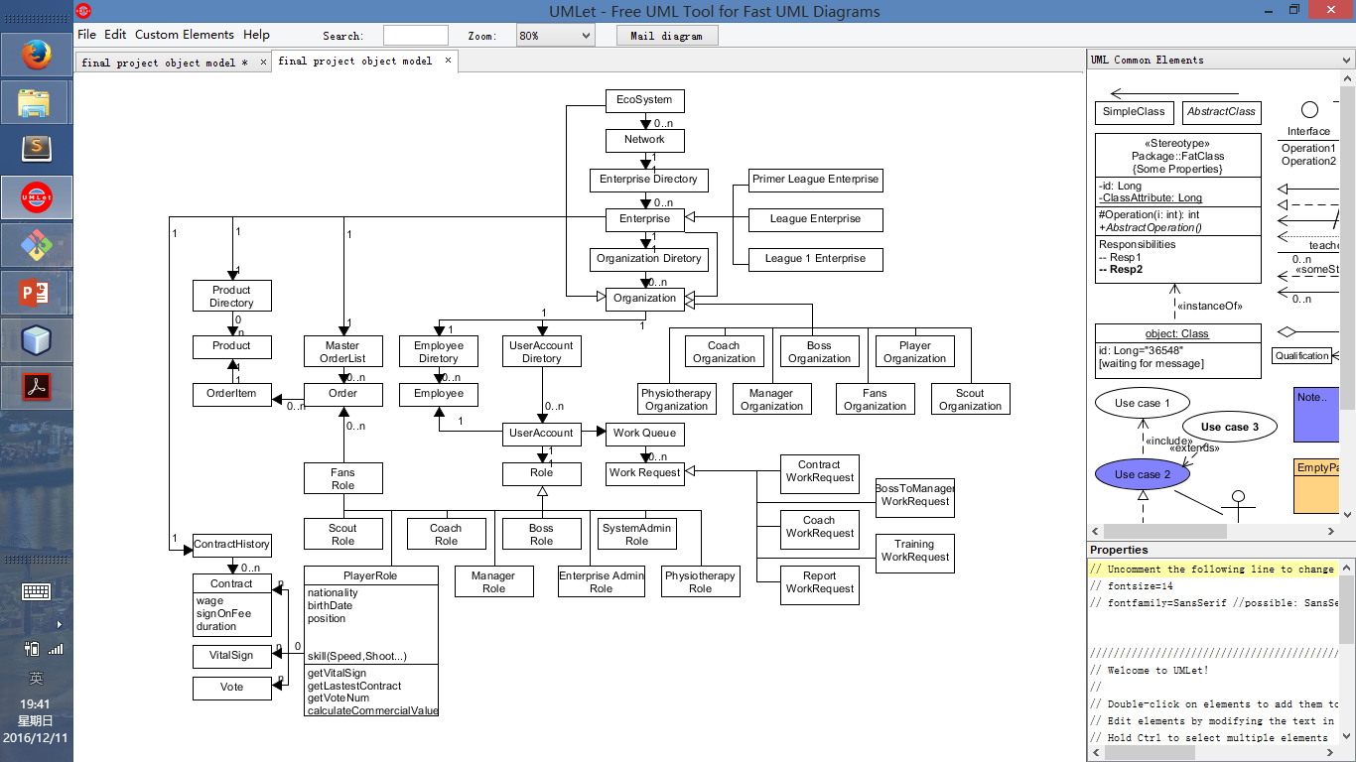
Object Model

Slide 8
Functional Architecture
Manager
The center of an enterprise that connect different kind of roles.
Evaluate the commercial players inside his club according to their healthiness, skill and popularity.
Scout
Search player to fulfill coach’s request.
Evaluate skills of player outside of his club.

Slide 9
Functional Architecture
Coach
Request new player.
Evaluate skill of the player inside the club and set training request to player.
President
Set Price According to Valuation

Slide 10
Functional Architecture
Marketing
Decide price & availability of products, like ticket & T-shirt;
President
Set price according to budget & valuation of player.
View the report of total transfer and other financial report of the club.

Slide 11
Functional Architecture
Physiotherapy
Have encounters with a player and record vital signs.
Evaluate healthiness of the player.
Fan
Customer of the club.
Vote for their favorite players.s

Slide 12
Process of a single Transfer:
Coach
Manager
Manager
Boss
Player
Scout

Slide 13
Reference
Big5 Transfer Window Analysis Summer 2016
Arsenal Holding PLC - Statement of Account and Annual Report 2015/16
Valuation of Football Players - A Complete Pricing Framework
Valuation of Soccer Player from Statistical Performance Data

Slide 14
THANK YOU

